Slide 1
T E X T E D I T O R

Slide 2
Overview of editing process
User interface
Editor structure

Slide 3
Allows to edit a text file
common editing features
Deleting
Replacing
Pasting
Saving
Searching
Windows OS - Notepad,WordPad,Microsoft Word.
UNIX OS - vi,emacs ,jed,pico

Slide 4
An interactive editor is a computer program that allows a user to create and revise a target document
Document includes objects such as computer diagrams, text, equations, tables, line art, photographs etc…
In text editors, character strings are the primary elements of the target text.

Slide 5
Document-editing process in an interactive user computer has four tasks:
Select the part of the target document to be viewed and manipulated
Determine how to format this view on-line and how to display it
Specify and execute operations that modify the target document
Update the view appropriately

Slide 6
Types of editors
Manuscript-oriented editor :
Manuscript-oriented editor is associated with characters, words, lines, sentences and paragraphs
Program oriented editors:
Program-oriented editors are associated with identifiers, keywords, statements.

Slide 7
User interface
The user interface is concerned with
input devices
output devices
interaction language

Slide 8
INPUT DEVICES :
The input devices are used to enter elements of text being edited, to enter commands
Input Devices are divided into three categories:
text devices - keyboard
button devices - special function keys, symbols on the screen
Locator devices - mouse, data tablet.
.
There are voice input devices which translates spoken words to their textual equivalents

Slide 9
OUTPUT DEVICES :
The output devices, lets the user view the elements being edited and the results of the editing operations
Some of the output devices are
Teletypewriters(first output devices)
(Cathode ray tube (CRT) technology)
TFT Monitors
Printers (Hard-copy)

Slide 10
INTERACTION LANGUAGE :
The interaction language provides communication with the editor
The interaction language could be
typing oriented or text command oriented
Typing oriented or text command oriented interaction was with oldest editors, in the form of use of commands, use of function keys, control keys
menu-oriented user interface
Menu-oriented user interface has menu with a multiple choice set of text strings or icons.
Display area for text is limited
Menus can be turned on or off.

Slide 11
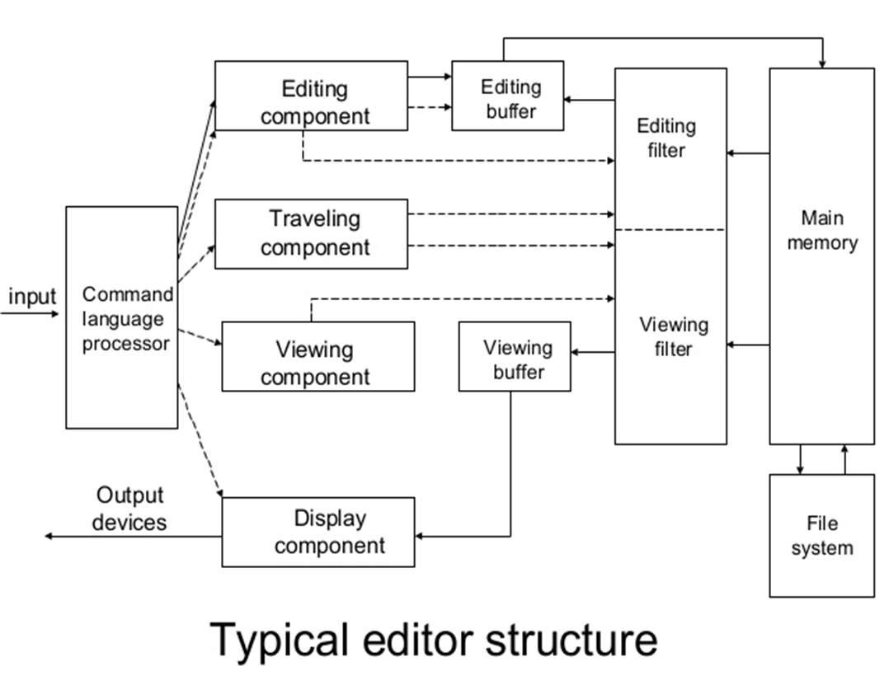
EDITOR STRUCTURE

Slide 12
Command language Processor accepts command, uses semantic routines – performs functions such as editing and viewing
The semantic routines involve traveling, editing, viewing and display functions.
Editing operations are specified explicitly by the user
Display operations are specified implicitly by the editor
Traveling and viewing operations may be invoked either explicitly by the user or implicitly by the editing operations

Slide 13
In editing a document,
the start of the area to be edited is determined by the current editing pointer maintained by the editing component
Editing component is a collection of modules dealing with editing tasks
Current editing pointer can be set or reset due to next paragraph, next screen, cut paragraph, paste paragraph etc..,.

Slide 14
When editing command is issued,
editing component invokes the editing filter
generates a new editing buffer
contains part of the document to be edited from current editing pointer.
Filtering and editing may be interleaved, with no explicit editor buffer being created.

Slide 15
In viewing a document,
the start of the area to be viewed is determined by the current viewing pointer maintained by the viewing component.
Viewing component is a collection of modules responsible for determining the next view
Current viewing pointer can be set or reset as a result of previous editing operation

Slide 16
When display needs to be updated,
viewing component invokes the viewing filter – generates a new viewing buffer
contains part of the document to be viewed from current viewing pointer
In case of line editors – viewing buffer may contain the current line
Screen editors - viewing buffer contains a rectangular cutout of the quarter plane of the text

Slide 17
Viewing buffer is then passed to the display component of the editor, which produces a display by mapping the buffer to a rectangular subset of the screen – called a window.
The editing and viewing buffers may be identical or may be completely disjoint
Identical – user edits the text directly on the screen
Disjoint – Find and Replace
(For example, there are 150 lines of text, user is in 100th line, decides to change all occurrences of ‘text editor’ with ‘editor’).

Slide 18
The editing and viewing buffers can also be partially overlapped, or one may be completely contained in the other Windows typically cover entire screen or a rectangular portion of it.
May show different portions of the same file or portions of different file
Inter-file editing operations are possible.

Slide 19
The components of the editor deal with a user document on two levels :
main memory
disk file system
Loading an entire document into main memory may be infeasible – only part is loaded – demand paging is used – uses editor paging routines.
Documents may not be stored sequentially as a string of characters
Uses separate editor data structure that allows addition, deletion, and modification with a minimum of I/O and character movement.

Slide 20
Editors function in three basic types of computing environments:
Time sharing
Stand-alone
Distributed
Each type of environment imposes some constraints on the design of an editor.

Slide 21
TIME SHARING ENVIRONMENT:
In time sharing environment, editor must function swiftly within the context of the load on the computer’s processor, memory and I/O devices.

Slide 22
STAND ALONE ENVIRONMENT
In stand-alone environment, editors on stand- alone system are built with all the functions to carry out editing and viewing operations
The help of the OS may also be taken to carry out some tasks like demand paging.

Slide 23
DISTRIBUTED ENVIRONMENT :
In distributed environment, editor has both functions of stand-alone editor; to run independently on each user’s machine and like a time sharing editor, contend for shared resources such as files

